Slide 1


Neuromania
Pivotato
Carey Lai, Chester Koh, Macarius Eng

Slide 2
Synopsis
Cody is a poor bullied boy in school because he likes to study.
He has no friends → very susceptible to alternative forms of company.
What will happen to him?

Slide 3


“Villains” aka temptations
Cool Trio – Dash, Antonio and Axel
Ecster and Friend

Slide 4
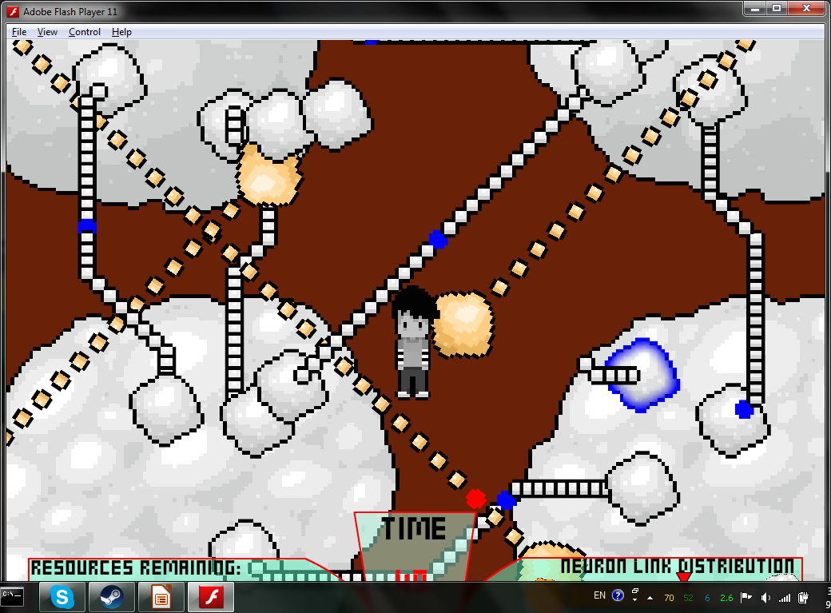
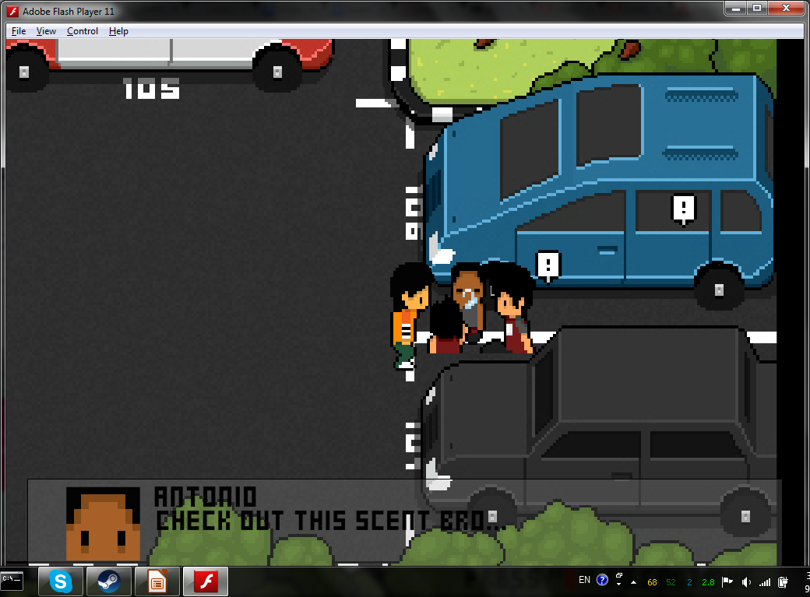
Gameplay

Slide 5
Objective of the game
Say NO to Drugs literally!

Slide 6
Demonstration

Slide 7
Future Development
Added to our CCA website for all to play to further promote message (did that for last year’s entry)
Showed during our CCA booth displays during open houses

Slide 8
Q&A

